Slide 1
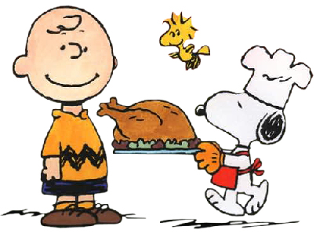
Jermyn Borough Council Meeting
11/19/20
This Photo by Unknown Author is licensed under CC BY-ND

Slide 2
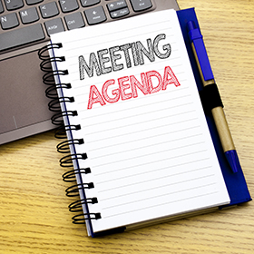
Meeting Agenda
Call to Order
Pledge of Allegiance
Roll Call
Previous Meeting Minutes
Treasurer’s Report/Bills Payable
Correspondence
Public Comment
2021 Budget
Stop Sign Ordinance (Garfield Ave/Raymond Dr.)
LSA Grant Resolutions
Rental Ordinance Discussion
New Business
Adjournment

Slide 3
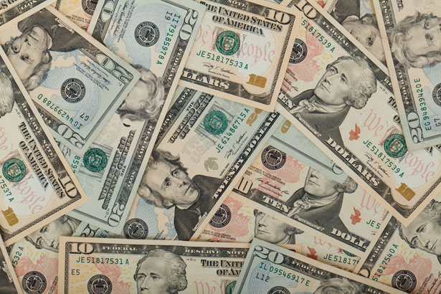
Treasurer’s report
November 19, 2020
ASSETS
Capital Reserve - DPW 13,427.45
Capital Reserve - Police 2,606.44
Crime Watch Fund 755.44
General Fund - Community 191.597.22
General Fund - FNB 1,975.68
Holiday Lights Fund 543.90

Slide 4
Treasurer’s report
Investment - General Fund 1.39
Investment - Liquid Fuels 34,291.59
Investment - Paving Fund 11.91
Investment - Recycling 2,002.59
Investment - Refuse 2,604.00
Liquid Fuels - FNB 32,426.36
Petty Cash 176.42
Recreations Fund 8,756.02
Recycling - Community 11,645.86
Refuse Checking - FNB 46,193.78
Total Checking/Savings 357,620.63

Slide 5
Treasurer’s report
Current Liabilities
Accounts Payable
200000 · Accounts Payable 37,521.12

Slide 6
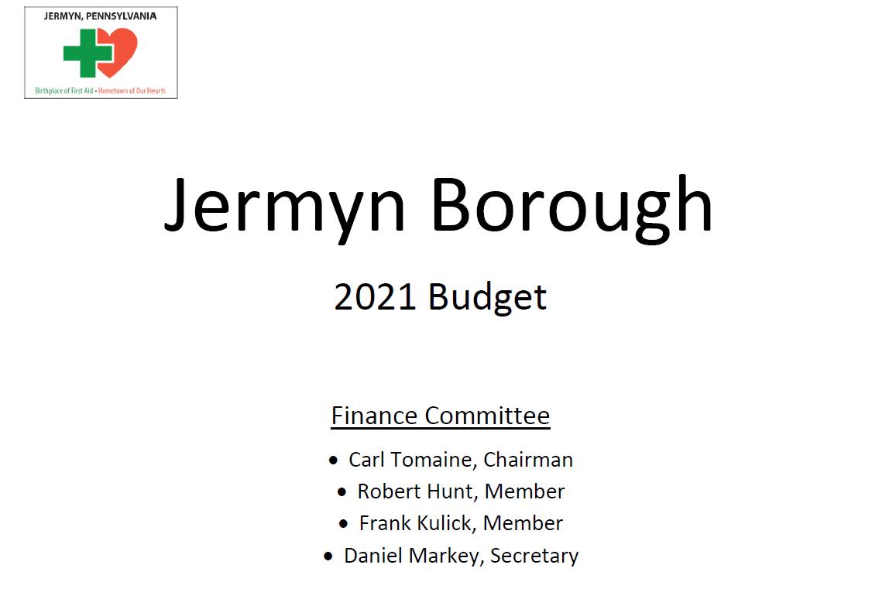

Slide 7
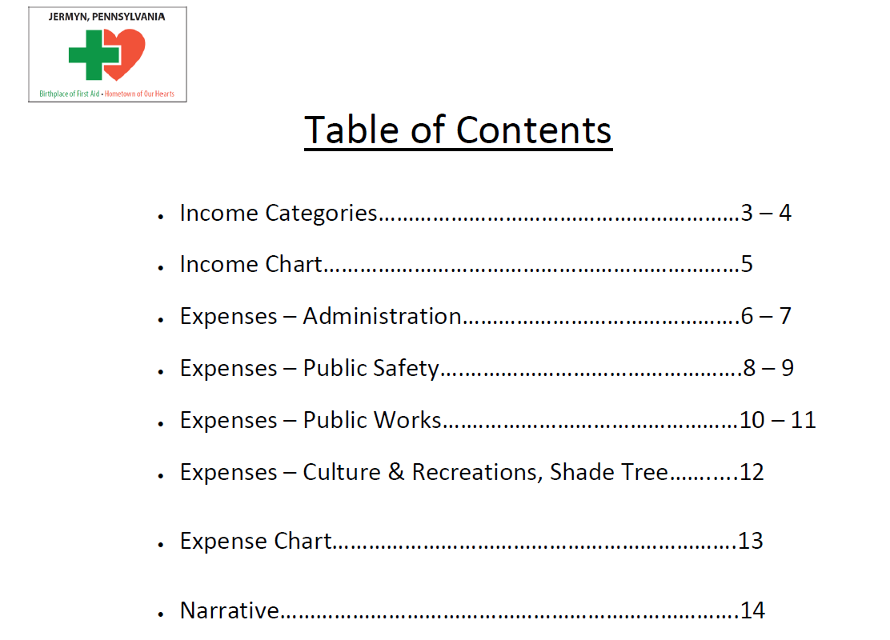

Slide 8
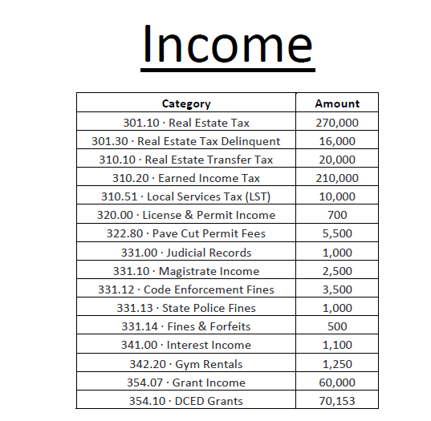

Slide 9
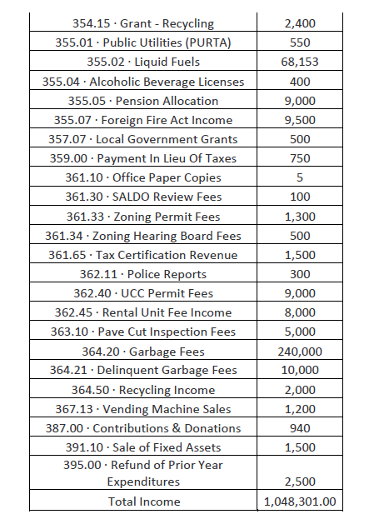

Slide 10
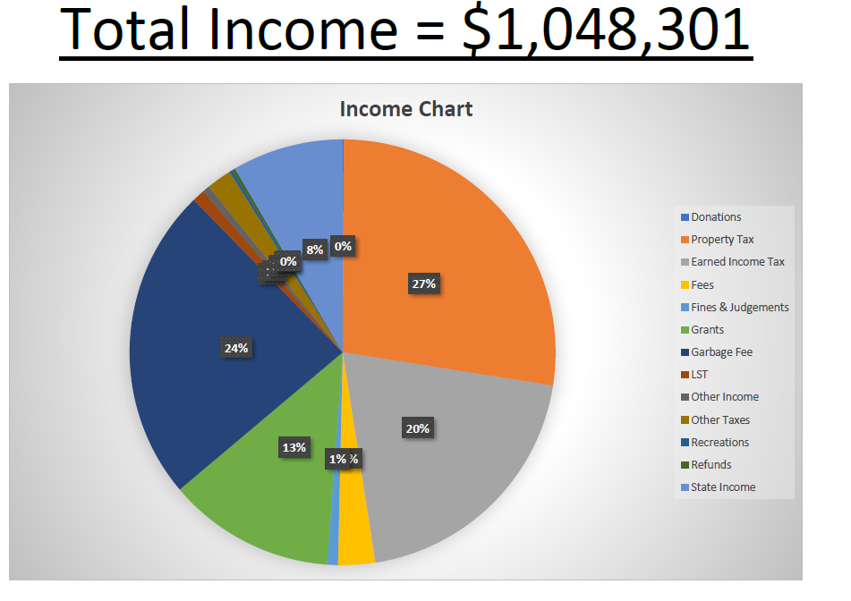

Slide 11
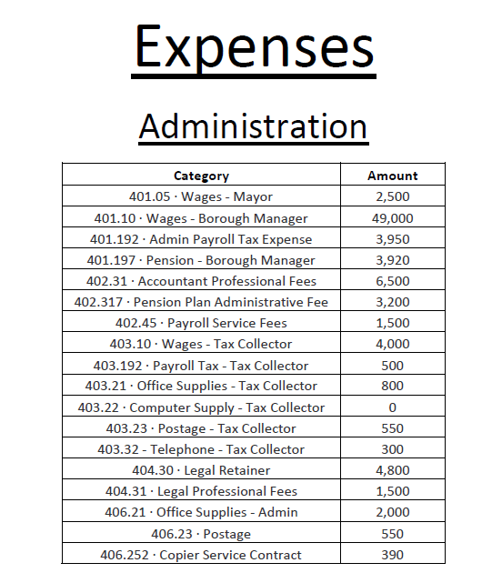

Slide 12
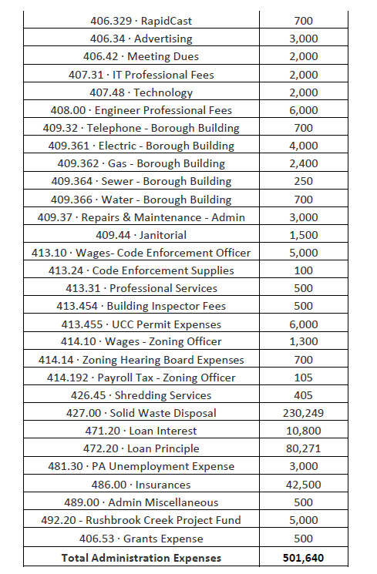

Slide 13
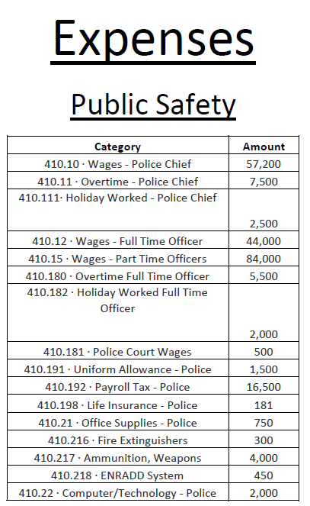

Slide 14
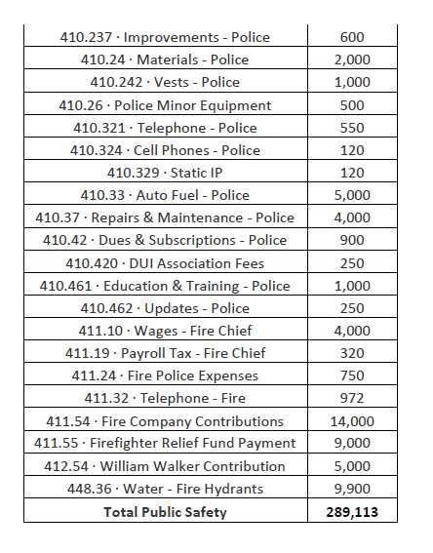

Slide 15
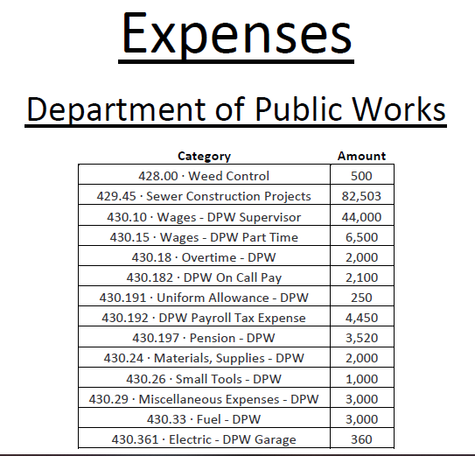

Slide 16
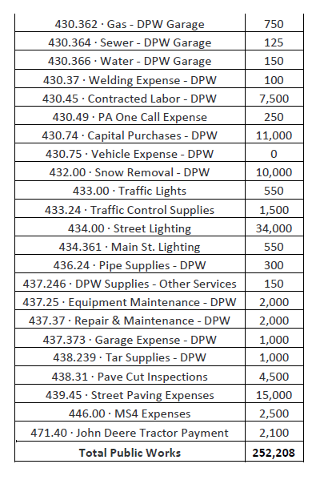

Slide 17
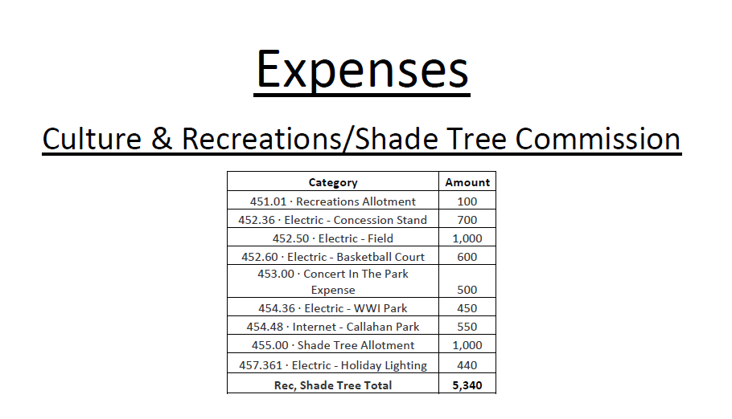

Slide 18
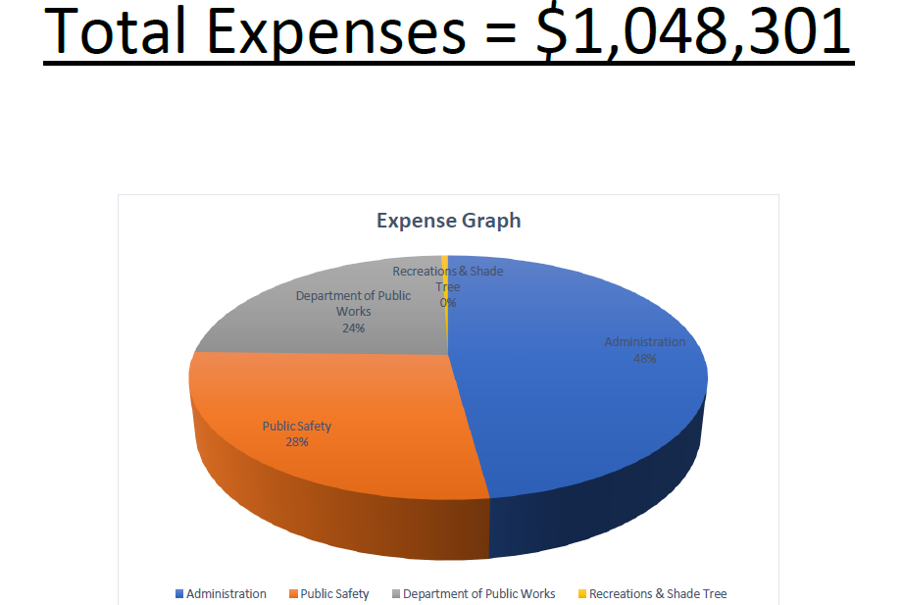

Slide 19
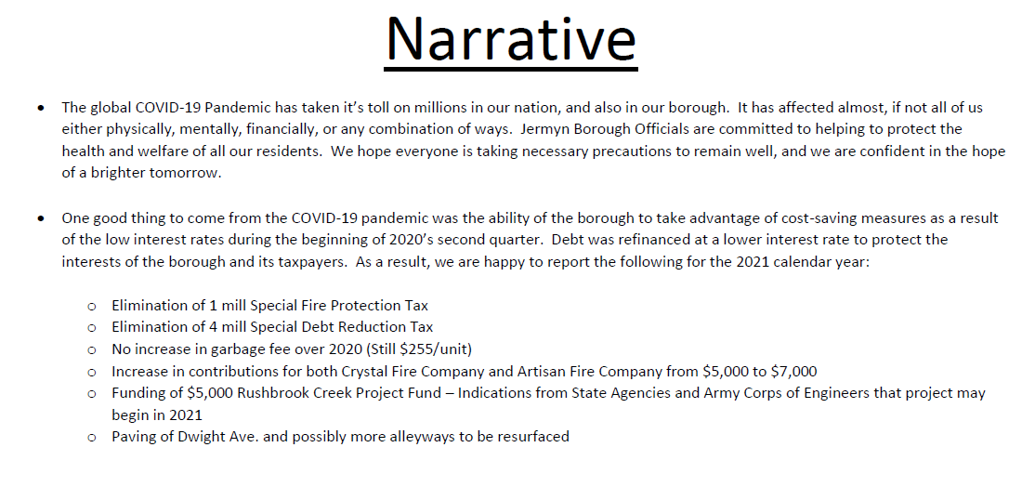

Slide 20


